Slide 1
Automated Generation of Executive Summaries for Meetings using NLP
Presented By:
B. Sujith Kumar
Mohd Ramzan Shareef
Mohd Arbaz Ahmed
Batch: CBIT/IT/2024-25/IT2/202
Project Guide:
Dr. B. Swathi Sowmya

Slide 2
Contents
01
02
03
04
05
06
07
08
09
Introduction
Problem Statement
Objectives
Methodology
Literature Survey
Dataset
Implementation
Results
Conclusion

Slide 3

01
Introduction

Slide 4
Introduction
Online meetings are essential for communication in today's fast-paced work environment, with platforms like Google Meet, Zoom, and Microsoft Teams being widely used.
The increasing volume of meetings makes it challenging to keep track of key points, decisions, and action items.
Our project uses Natural Language Processing (NLP) techniques to automatically summarize online meetings.
The system captures audio from meeting audio files, transcribes the content into text, processes it using NLP algorithms, and generates summaries. These summaries highlight the main topics, decisions, and action items discussed during the meetings.
The solution saves time and ensures that important information is easily accessible, helping professionals stay organized and efficient.

Slide 5
02
Problem Statement

Slide 6
2. Problem Statement
The shift to remote work has increased the frequency of online meetings, leading to information overload, time-consuming review processes, and inconsistent note-taking. Busy professionals struggle to identify key highlights such as action items and decisions within lengthy dialogues, making it challenging to retain essential information.
There is a need for an automated, accurate solution that can efficiently summarize meetings using NLP and machine learning, integrated into a user-friendly SaaS browser extension.

Slide 7
03
Objectives

Slide 8
3. Objectives
Develop an NLP-based system to automatically capture and summarize key points, decisions, and action items from online meeting, enhancing accessibility and organization for busy professionals.
Implement a user-friendly Chrome extension that integrates with popular meeting platforms (e.g., Google Meet, Zoom, Teams) to enable summarization directly within the browser.
Increase the summarization accuracy and efficiency by utilizing advanced NLP techniques, such as extractive and abstractive summarization, to ensure concise and relevant summaries for end-users.

Slide 9
04
Literature Survey

Slide 10
4. Literature Survey
Paper Title | Methodology | Observations | Research Gap
Meeting Summarizer using Natural Language Processing (Geethika Vadlamudi - 2022) (IEEE Xplore) (10.1109/ICOEI53556.2022.9777155) | The methodology integrates NLP tools, specifically TF-IDF and TextRank algorithms, to preprocess transcripts, extract relevant content, and rank sentences based on their importance. This approach is designed to produce extractive summaries, focusing on selecting key sentences from the original text. | The approach reduces manual effort in summarizing meetings, providing quick and efficient access to important information discussed in meetings. It leverages well-established NLP techniques to ensure relevance and accuracy in summaries. | Extractive summarization might miss out on providing a coherent narrative if key points are distributed across non-contiguous sentences. Lacks the capability to generate novel sentences that capture the essence of discussions more effectively.
Automatic Meeting Minutes Generation Using Natural Language Processing (Satish Muppidi, Jayanthi Kandi- 2023) (IEEE Xplore) (10.1109/EASCT59475.2023.10393102) | Proposes a model that uses NLP techniques to automatically generate meeting minutes. It converts speech to text and summarizes key points, focusing on extracting action items. The approach leverages models like BART, T5, and a Summarization Pipeline. | The system effectively automates the process of generating concise meeting minutes. It reduces the need for manual transcription and note-taking, saving time and minimizing human errors. High accuracy in generating summaries, as indicated by the ROUGE scores. | May suffer from noise and transcription errors in audio to text conversion, which could affect the quality of the generated summaries. May miss certain nuances of human conversation that require a deeper understanding of context.

Slide 11
Paper Title | Methodology | Observations | Research Gap
Minutes of Meeting Generation for Online Meetings Using NLP & ML Techniques (Renu Kachhoria, Netal - 2024)(IEEE Access) (1109/ESCI59607.2024.10497256) | The methodology includes converting audio to text using the Whisper AI model, followed by speaker diarization with pyAnnote. The text is then summarized using a combination of abstractive and extractive summarization models, including PEGASUS, BART, and a customized summarization pipeline. Effectiveness is measured using ROUGE. | The use of multiple summarization models enhances the accuracy and relevance of the generated summaries. Integration of speaker diarization ensures that the meeting minutes accurately reflect who said what during the meeting. The model’s flexibility allows it to process various audio formats. | The complexity of integrating multiple models and techniques could lead to increased computational requirements. The accuracy of the speaker diarization may vary depending on the quality of the audio, which could impact the final summaries.
Video Based Transcript Summarizer for Online Courses using Natural Language Processing (Krishna Kulkarni, Rushikesh - 2021) (IEEE Transactions) (1406) | Involves two main NLP algorithms: Term Frequency-Inverse Document Frequency (TF-IDF) and the Gensim library for topic modeling. The system allows users to input a video URL, select a summarization model, and specify the desired summary length. The system uses TF-IDF . | The use of both TF-IDF and Gensim offers flexibility in generating summaries, allowing users to choose the most appropriate method for their needs. The system can process online course videos efficiently, providing a valuable tool for students to quickly review content. | The system’s reliance on transcript quality could affect the accuracy of the summaries if the transcripts are incomplete. Methods may not fully capture the context or subtleties of more complex educational content.

Slide 12
Paper Title | Methodology | Observations | Research Gap
A Ranking based Language Model for Automatic Extractive Text Summarization (Pooja Gupta. - 2021) (IEEE Access) (10.1109/ICAITPR51569.2022.9844187) | Uses an n-gram language model to perform extractive summarization. The model ranks sentences by calculating unigram, bigram, and trigram probabilities and selects sentences with the highest cumulative scores to form the summary. | The ranking-based approach achieved reasonable summarization accuracy with ROUGE scores evaluated on the BBC and CNN news datasets, showing a higher accuracy on the BBC dataset (44%) than CNN (36%). | Limited accuracy and coherence in summaries, with a need for improvements to handle larger, diverse datasets effectively and enhance context understanding beyond simple n-gram modeling.
Write Summary Step-by-Step: A Pilot Study of Stepwise Summarization (Xiuying Chen - 2024) (IEEE Transactions) (1406) | Involves a step-by-step approach to summarization, using various NLP techniques to refine the summary. This includes tasks like text segmentation, keyword extraction, sentence ranking, and final summary generation. | The stepwise approach may lead to more controlled and transparent summarization processes, potentially increasing accuracy and allowing for better optimization of each summarization step. | The multi-step process could be more computationally intensive and time-consuming compared to end-to-end models. It might also require more fine-tuning to handle different text types effectively.

Slide 13
05
Methodology

Slide 14
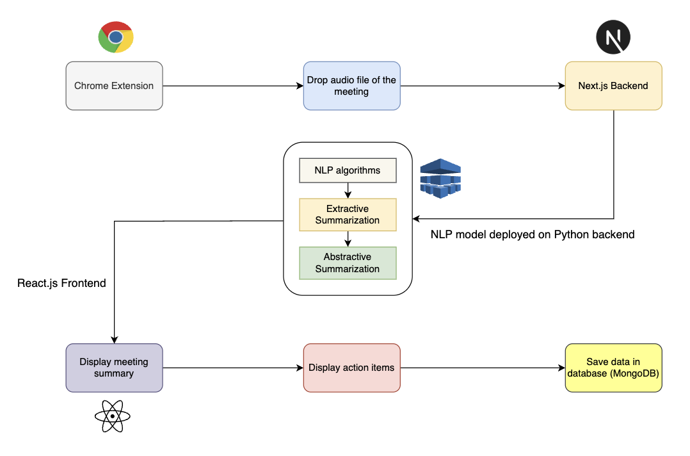
5. Proposed System

Slide 15
5. Proposed System
Built as a Chrome extension, providing easy access within the browser to capture and summarize meeting audio.
Backend uses Next.js for handling transcription, summarization, and user data via REST APIs.
Workflow: Audio is captured, transcribed, preprocessed, segmented, summarized, and displayed in the user dashboard.
User dashboard developed with ReactJS allows users to view, edit, and manage summaries.
Technical components include a ReactJS front-end, Node.js and Express.js backend, and integration with NLP libraries and transformer models for summarization and entity recognition.

Slide 16
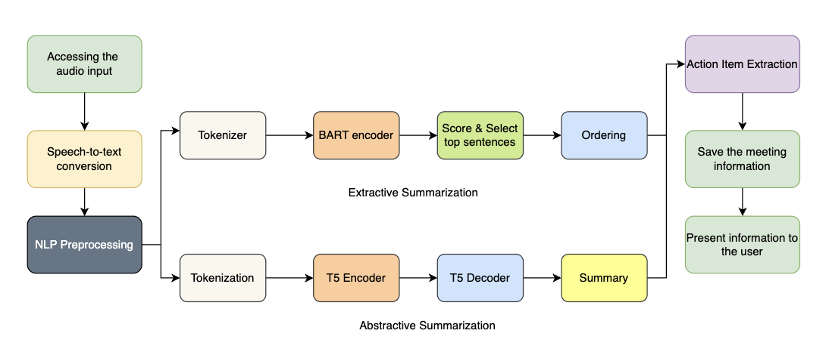
5. Methodology

Slide 17
5. Methodology
Captures audio from online meetings on platforms like Google Meet, Zoom, and Teams using the Chrome extension.
Converts audio to text with Speech-to-Text models, ensuring high accuracy.
Preprocesses text by removing filler words and standardizing words for clearer, structured input.
Applies extractive summarization using BART to capture main discussion points based on word frequency and sentence importance.
Uses abstractive summarization models (T5) to rephrase and produce fluent, concise summaries from the transcript.
Integrates Named Entity Recognition (NER) to identify key people, dates, and roles, and uses a classifier to extract action items for tracking tasks and decisions.

Slide 18
06
Dataset

Slide 19
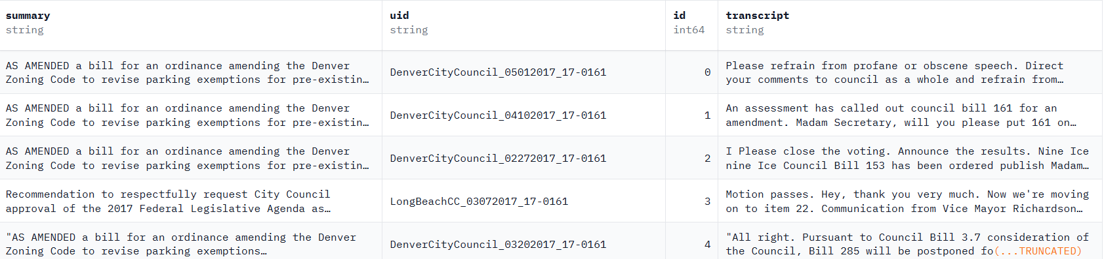
6. Dataset
huuuyeah/meetingbank · Datasets Hugging Face

Slide 20
6. Dataset
About Dataset
Dataset Content: Contains transcripts, meeting minutes, agendas, and metadata for city council meetings.
Meeting Duration: On average, each meeting lasts 2.6 hours with transcripts containing over 28,000 tokens.
Total Data: 1,366 meetings from 6 U.S. cities, with 3,579+ hours of content.
Format: Available in JSON format.
Category | No.of rows
Training | 5.17k
Validation | 861
Testing | 862

Slide 21
07
Implementation

Slide 22
7. Implementation
Transcript Preprocessing The raw meeting transcript is cleaned using NLP libraries (like SpaCy/regex), involving:
Removal of timestamps, filler words
Sentence segmentation using SpaCy
Conversion to lowercase and normalization
Tokenization using T5 Tokenizer The cleaned text is tokenized using the T5 Tokenizer. The input is prefixed with the task directive (e.g., "summarize: <text>") before tokenization. This helps the model learn task-specific behavior.
Fine-Tuning the T5 Model
Pretrained T5-base is fine-tuned on the MeetingBank dataset.
Model learns to map full meeting transcripts → concise summaries.
Training is done for 3 epochs on ~5500 samples with Early Stopping and ROUGE score monitoring.

Slide 23

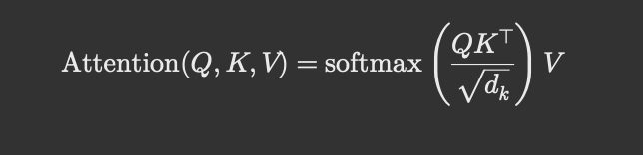
7. Implementation
Model Architecture Internals
T5 is an encoder-decoder transformer. The encoder encodes input into embeddings.
Decoder auto regressively generates summary one token at a time.
x = The input sequence (meeting transcript)
Encoder(x) = Encodes the input sequence into a dense vector representation.
Y = All previously generated tokens before timestep t.
Decoder(Y{<t}, Encoder(x)) = The decoder uses both the encoder output and previously generated tokens to predict the next token Y_t.
The dot product QK^{T} computes similarity scores between tokens. These are scaled by \sqrt{d_k} to maintain numerical stability, then passed through softmax to get attention weights. Finally, a weighted sum of the values produces the output.

Slide 24
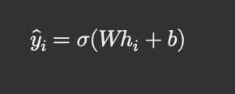
7. Implementation
Sentence Encoding via BART Encoder: Each sentence is tokenized using the BartTokenizer and passed through the pre-trained BART model’s encoder to extract contextual embeddings.
Sentence Scoring Head: A classification head (usually a linear layer) is applied on top of the encoder outputs. It assigns a relevance score for each sentence, typically through a sigmoid activation
W * h_{i} + b: Performs a weighted sum of the embedding features, outputting a single scalar score for the sentence. The sigmoid activation function, used to squash the output into the range [0, 1]. This score represents the probability or relevance of the sentence being selected for the summary.
h_{i}: The contextual embedding vector for sentence i from the encoder W and b: Learnable parameters — weight matrix and bias term of the linear (dense) layer.

Slide 25
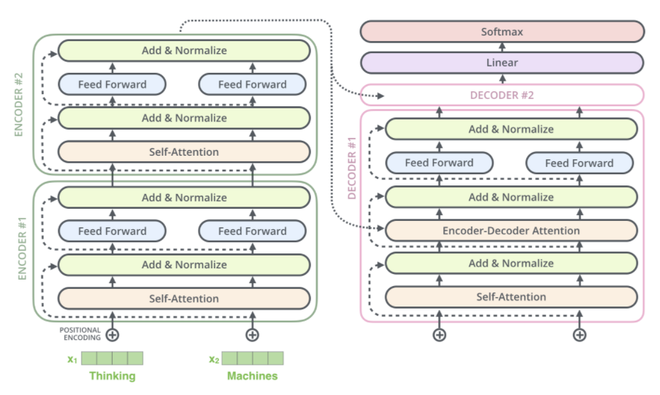
7. Implementation
Text-to-Text Transfer Transformer (T5) model

Slide 26
08
Results

Slide 27
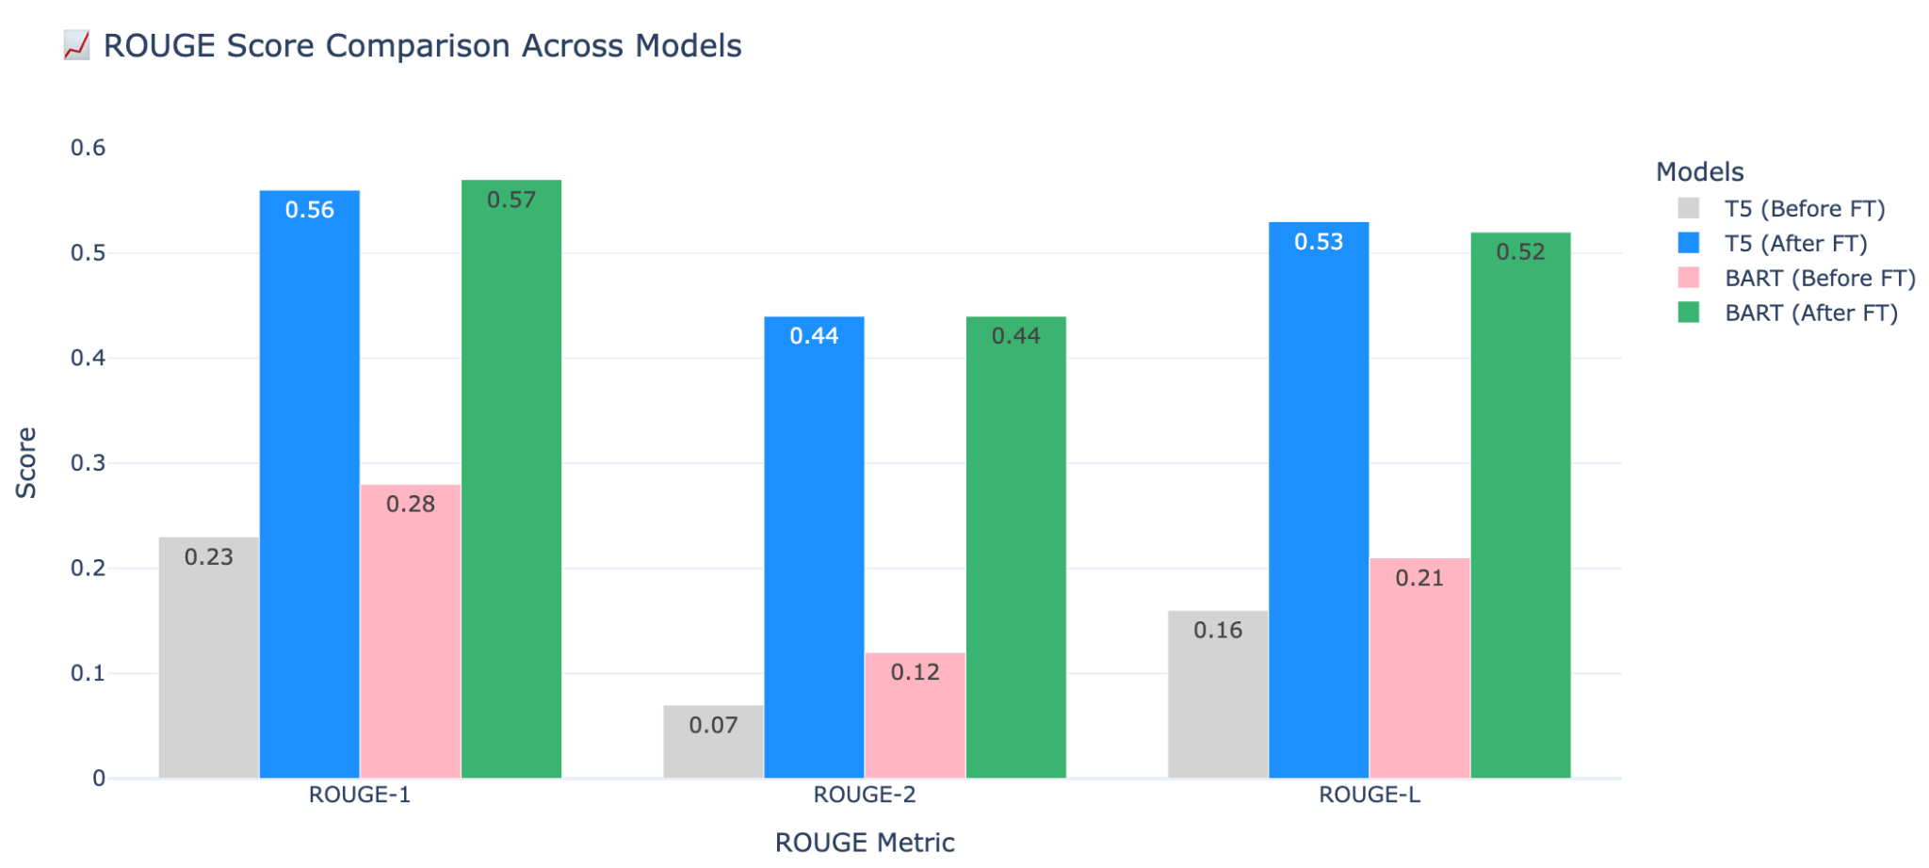
8. Results

Slide 28
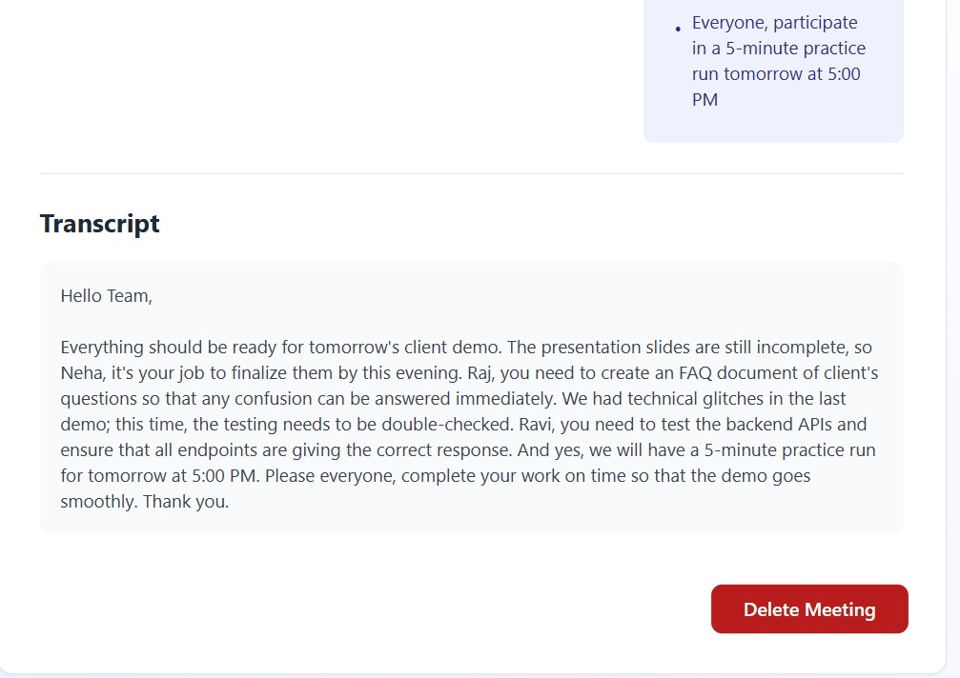
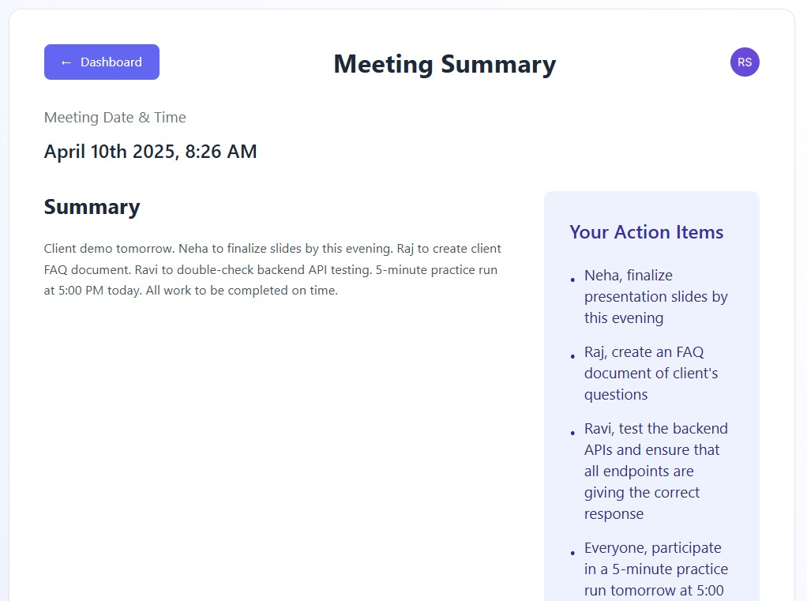
8. Results

Slide 29
09
Conclusion

Slide 30
9. Conclusion
The project focuses on leveraging Natural Language Processing (NLP) to automate meeting summarization. By integrating speech-to-text models, extractive and abstractive summarization techniques, we ensure an efficient and accurate summarization process. These enhancements contribute to better information retention, helping professionals stay organized and productive.
The developed system effectively captures key discussion points, decisions, and action items from online meetings. The integration of machine learning models strengthens summary relevance and coherence, offering a practical solution for automated executive summaries in virtual meetings.

Slide 31
References
J. Yan and S. Zhou, “A Text Structure-based Extractive and Abstractive Summarization Method,” 7th International Conference on Intelligent Computing and Signal Processing (ICSP), Xi’an, China, 2022, pp. 678-681, doi: 10.1109/ICSP54964.2022.9778497.
N. Bharti et al., “An Approach for Audio/Text Summary Generation from Webinars/Online Meetings,” 13th International Conference on Computational Intelligence and Communication Networks (CICN), Lima, Peru, 2021, pp. 6-10, doi: 10.1109/CICN51697.2021.9574684.
S. Muppidi et al., “Automatic Meeting Minutes Generation Using Natural Language Processing,” International Conference on Evolutionary Algorithms and Soft Computing Techniques (EASCT), Bengaluru, India, 2023, pp. 1-7, doi: 10.1109/EASCT59475.2023.10393102.
A. M. et al., “Automation of Text Summarization Using Hugging Face NLP,” 5th International Conference for Emerging Technology (INCET), Belgaum, India, 2024, pp. 1-7, doi: 10.1109/INCET61516.2024.10593316.
Bhat et al., “Jotter: An Approach to Summarize the Formal Online Meeting,” International Conference on Ambient Intelligence, Knowledge Informatics and Industrial Electronics (AIKIIE), Ballari, India, 2023, pp. 1-6, doi: 10.1109/AIKIIE60097.2023.10390455.
Mahadevan et al., “Minutes: Hybrid Text Summarizer for Online Meetings,” 14th International Conference on Computing, Communication, and Networking Technologies (ICCCNT), Delhi, India, 2023, pp. 1-7, doi: 10.1109/ICCCNT56998.2023.10306385.

Slide 32
Thank You!

